Slide 1
E-MEDICARE
PROJECT MEMBERS :-
1. Abbas S
2. Aishwarya Anil Khaladkar
3. Aishwarya Gobbanavar
4. Aishwarya Guruling Nagare
5. Akarsh M
6. Akshay Manoj Bansode
7. Akshay V S
8. Akuleti Rohith Reddy
9. Ankit Mishra
10. Banavath Vijay Nayak

Slide 2
ABSTRACT
The purpose of E-Medicare System is to automate the existing manual system by the help of computerized equipment's and full-fledged computer software, fulfilling their requirements, so that their valuable data can be stored for a longer period with easy accessing and manipulation of the same.
E-Medicare System, as described above, can lead to error free, secure, reliable and fast management system.
The aim is to replace the existing manual system by E-Medicare , By Eliminating the middle man thus leading to the Profit of the company.

Slide 3
INTRODUCTION
The “Online E-Medicare Store” has been developed to override the problems prevailing in the practicing manual system. This software is supposed to eliminate and reduce the hardships faced by the existing system. Online Medical Store can lead to error free, secure, reliable and fast management system.
"Online E-Medicare Store" - web application ,where users can register, login, purchase medicines e.g. Antibiotics, Antipyretics. and manage their orders in the system.

Slide 4
PROPOSED SYSTEM
The proposed Online E-Medicare store system will completely Revolutionize the industry.
Searching of medicine, order medicine, billing and medicine stock can be maintained by a single click.
The order placed can be easily tracked At any time.

Slide 5
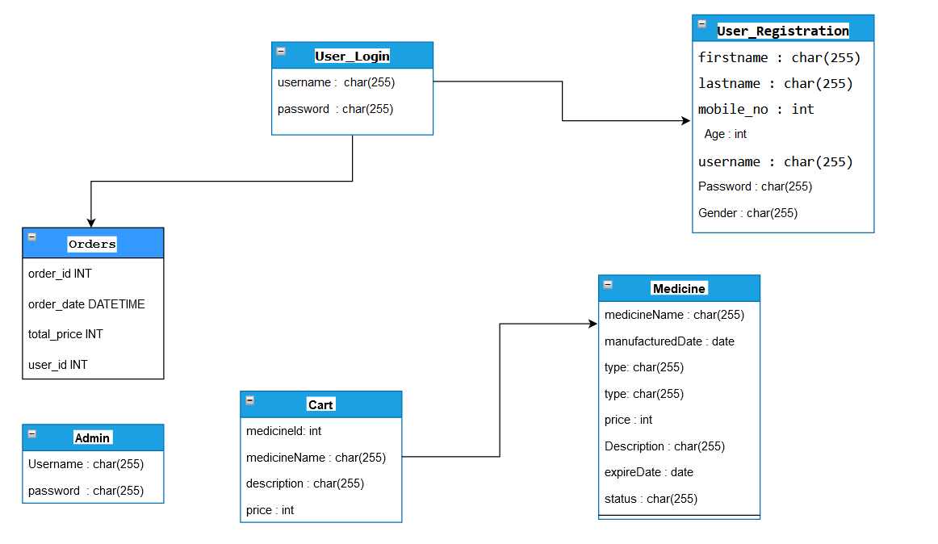
ER-DIAGRAM

Slide 6
TECHNOLOGY USED
HTML : Page layout has been designed in HTML
CSS : CSS has been used for all the designing part
JavaScript : All the validation task and animations has been developed by JavaScript
Java : All the business logic has been written in Java
MySQL : MySQL database has been used as database for the project
Angular CLI : Command-line interface tool that we use to initialize.

Slide 7
ENVIRONMENT
The system will be developed on any Windows OS machine using J2EE, Hibernate and Spring.
Server – Apache Tomcat 8
Database – My SQL
My SQL J Connector
Node Version 10
Angular CLI
JDK 1.8
Spring Tool Suite

Slide 8
MODULES OF E-MEDICARE SYSTEM
Admin Module: Used for managing medicine details.
Users Module: Used for managing the users of the system.
Login Module: Used for managing the login details.
Order Module: Used for managing the details of Order.
Medicine Module: Used for managing the Medicine details.
Cart Module: Used for managing the details of Cart.

Slide 9
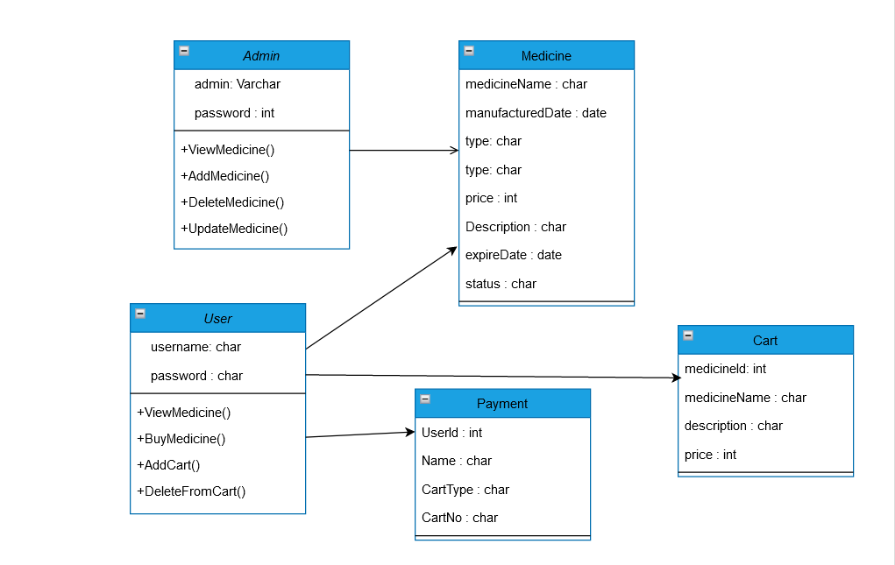
Class Diagram

Slide 10
SEQUENCE DIAGRAM
Customer
Application interface
Medicine
Order
medicine
Checkout
Browse & select medicine
Query medicine
Authorize
Purchase
Get selected medicine
Sends back
Contact
Display
Price info

Slide 11
ADVANTAGES
User can view details of the medicines Online.
It is convenient for users as this system provides accurate cost and description of the product.
The website is flexible to be used and for e-medicare.
User can view different categories of product of different pharma company at a single place.

Slide 12
Unit testing
JUnit is a unit testing framework for Java programming language. It plays a crucial role test-driven development, and is a family of unit testing frameworks collectively known as xUnit.
JUnit is an open source framework, which is used for writing and running tests.
Provides annotations to identify test methods.
Provides assertions for testing expected results.
Provides test runners for running tests.

Slide 13
Functional Testing using POSTMAN tool
Tests are automated by creating test suites that can run again and again.
Postman can be used to automate many types of tests including unit tests, functional tests, integration tests, end-to-end tests, regression tests, mock tests, etc. Automated testing prevents human error and streamlines testing.

Slide 14
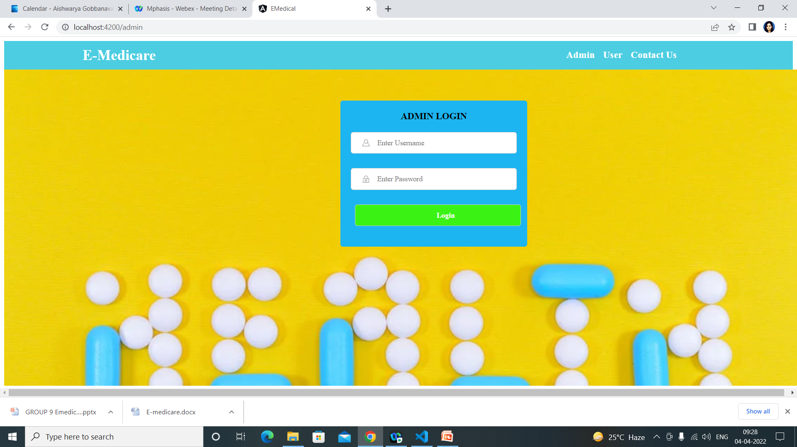
ADMIN LOGIN PAGE

Slide 15
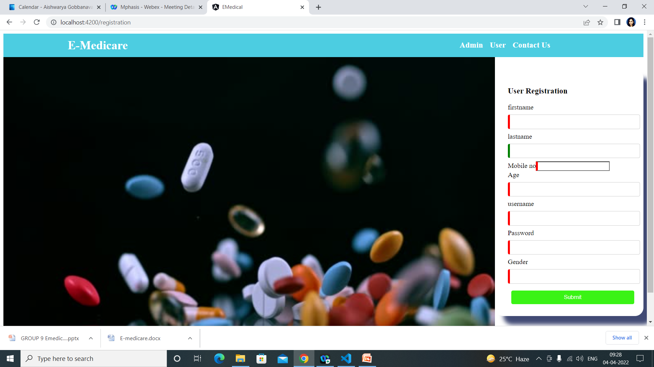
USER Registration

Slide 16
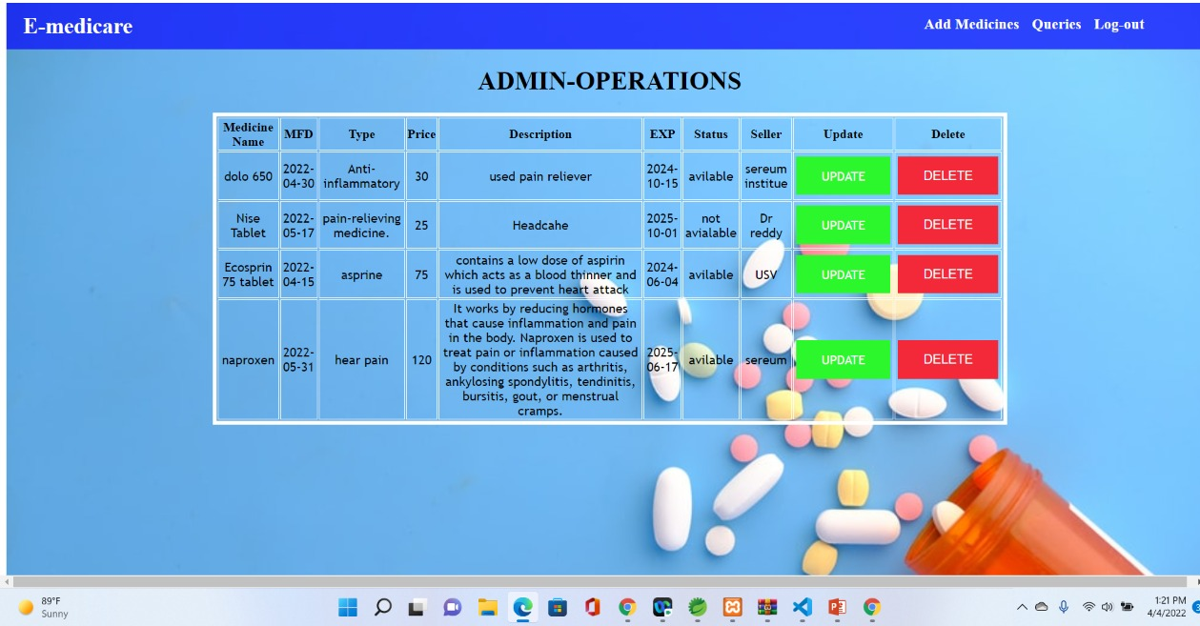
Admin operations

Slide 17
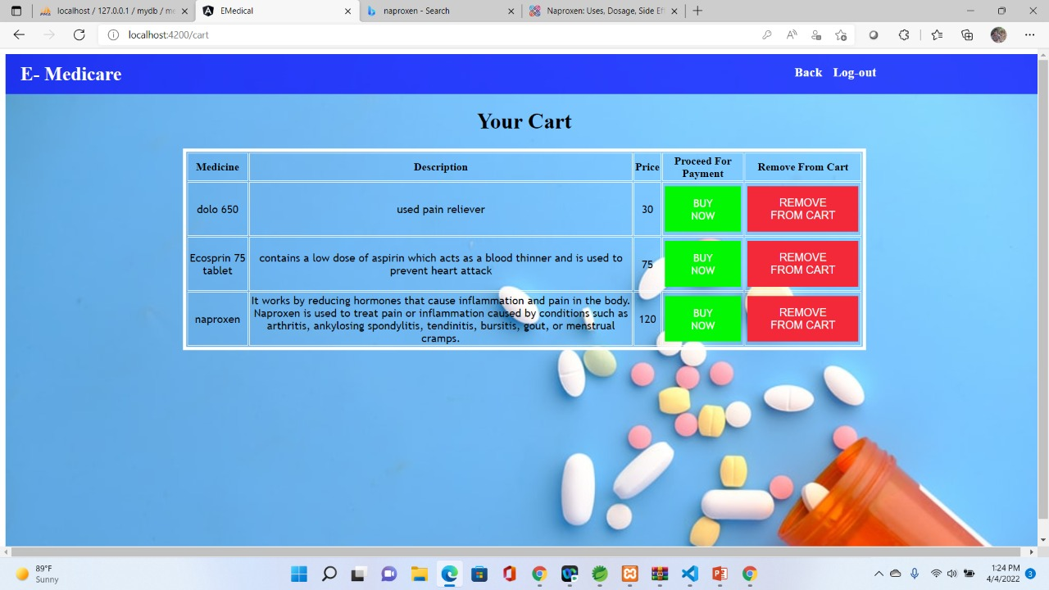
CART Page

Slide 18
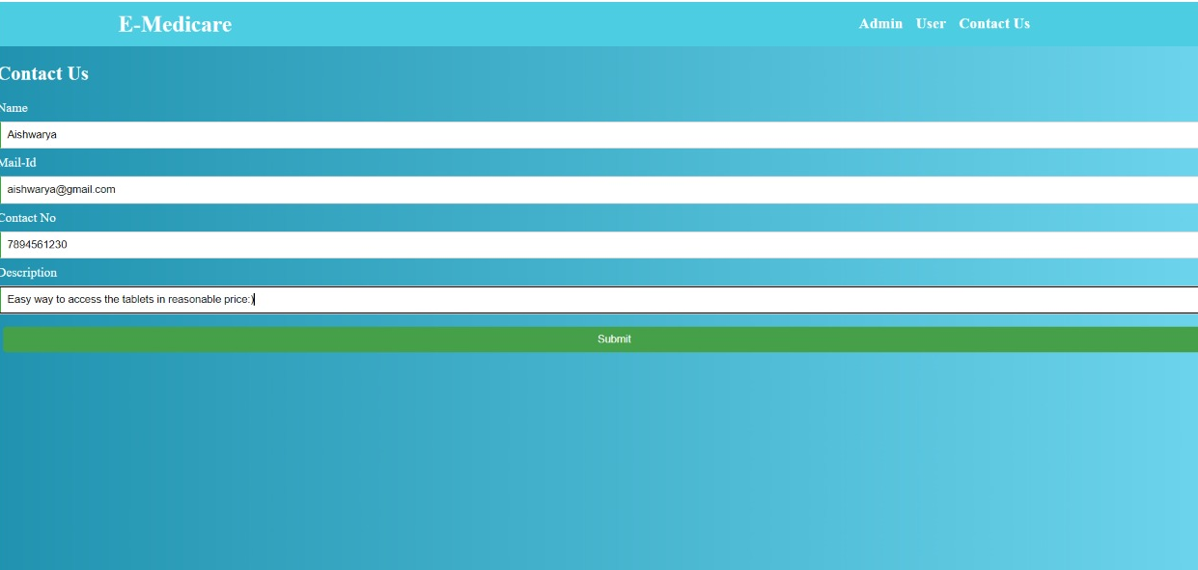
Contact Us

Slide 19
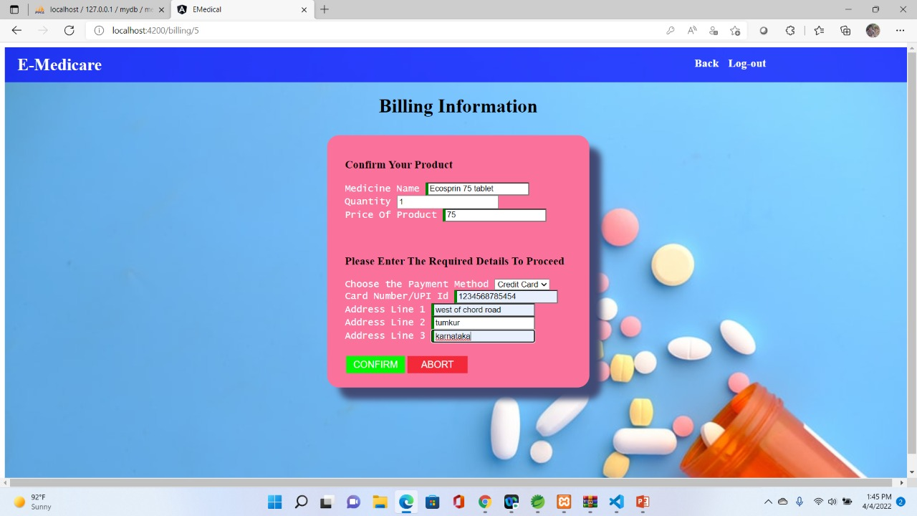
Payment Gateway

Slide 20
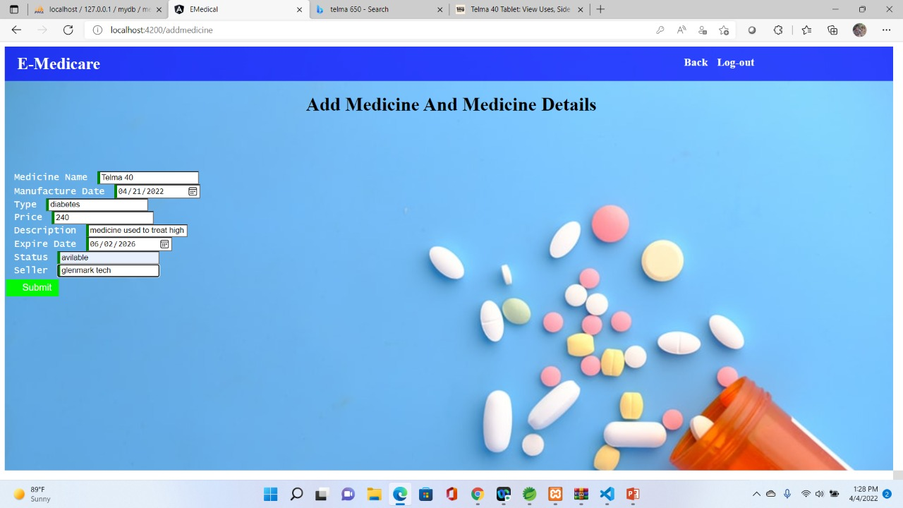
Update Medicine

Slide 21
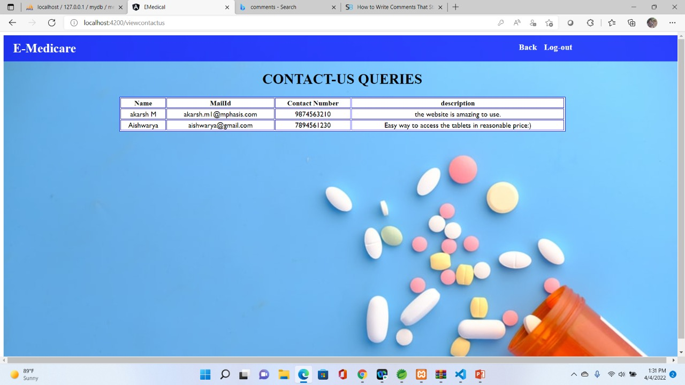
Contact Us Query Page

Slide 22
CONCLUSION
This E Medicare system is a web-based application that assists in management of medicine in easy, comfortable and effective service.
The proposed application aims to create a friendly working environment for any Medicare centers and to overcome the drawbacks in existing system of Medicare management.
We understand the problem domain and produce a model of the system, which describes operations that can be performed on the system.
We included features and operations in detail, including screen layouts.
We designed user interface and security issues related to system.
Finally, the system is implemented and tested according to test cases.

Slide 23
THANK YOU

